Slide 1
Deep Learning based Human Abnormal Activity Detection
Batch:344
P.SIVA-180030646
G.BHARATH-180030687
Guide: B.Prabha

Slide 2
Abstract
Abnormal activity detection plays an important role in many areas such as surveillance, military installations, and sports. Existing abnormal activity detectors mostly rely on motion data obtained over a number of frames to characterize abnormality. However, only motion may not be able to capture all forms of abnormality, in particular, poses that do not amount to motion "outliers".

Slide 3
Introduction
Today Human Behaviour And Pattern Of Human Activity Are Precious In Tracking And Detecting Human Behaviour.In Various Areas Cctv Cameras Are Being Used.Over The Course Of Time Various Processes Have Been Automated.Thus A Need Arises To Automate Video Surveillance Systems For Tracking Human Behaviour And Detection Of Suspicious Activities.With Help Of New Technology And Various Machine Learning Algorithms It Is Possible To Track Human Behaviour.Various Research es Have Been Performed In This Field To Try To Analyse And Detect Human Behaviour.

Slide 4
A Model Have Been Developed By Using Markov Logic To Try To Analyse Human Behaviour Using Second Order Predicate Logic.Also Objection Is Done Using The Concept Of Similar Pixels Form Same Objects.A Model Has Been Developed To Analyse The Motion Of Moving Objects.The Motion Influence Map Is Used Accordingly To Construct Behaviour. Use OpenCv Library Along With Tensor Flow Is Done To Find The Mapping Of Tensor Behaviour Of Objects.

Slide 5
Proposed System
We Propose A System Making Use Of Opencv Library Implemented In Python.Opencv Initially Developed By Intel For Image Processing.It Has Built In Function For Performing Various Actions On Images.It Makes Use Of Numpy Library To Store The Visual Images Into A Stream Of Frames.Basically An Image Is Broken Into Frames.Then This Images Are Stored In A Stream Of Bytes.Then Consecutive Frames Are Compared I.E If There Is A Movement Of A Certain Object Then That Byte Stream Representing That Object Will Change.So Comparing Streams Of Consecutive Frames Moving Objects Are Detected And Pattern Of Their Motion Is Recorded.By Analysing These Patterns The Nature Of Behaviour Of Objects Is Detected.

Slide 6
The Basic Steps Are:
1.Optical Flow Of Blocks
2.Calculate Optical Flow Of Every Blocks
3.Generate Motion Influence Map:
4.Feature Extraction

Slide 7
Working Of System
This System Requires Supervised Learning. Initially The System Is Trained Using Various Training
Samples. Various Kinds Of Behaviour Are Studied.
Finally A Test Data Is Given As Input. It Performs Feature Extraction And Analyses The Behaviour, Tracks Motion Of Objects And Finally Classifies The Type Of Activity.

Slide 8
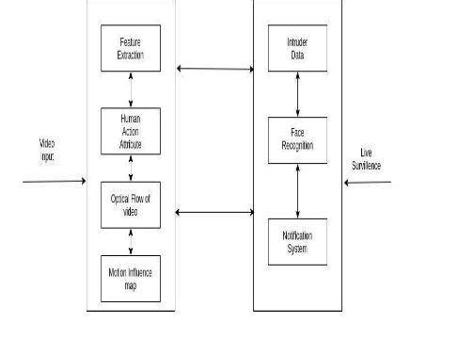

Slide 9
Future Scope
The System Can Be Merged With Face Detection System So As Whenever An Unusual Activity Is Detected The Identity Of Individuals Can Also Be Detected.Also Using Machine Learning Algorithms An
Effort Can Be Made To Predict The Unusual Activity Before The Activity Occurs.

Slide 10
Conclusion
An Analysis Of Detection Techniques Like Unusual I.E Suspicious Behaviour Of Human, Detection Of Motion.Suspicious User Activities Are Shown As Output By Our System.

Slide 11
References
L.Weexen, M.Vijaay, And V.Nunu, “Anomaly Detection And Localization In Over Crowded Scenes”,”
IEEE Transactions On Pattern Analysis And Machine Intelligence,”
G.Gayatri , S.Ghiriprasad, “Anomaly Detection For Intelligent Video Surveillance:A Survey”,2015

